Slide 1

Apartment Rentals
ANOTHER RETARGETING SUCCESS STORY
GEO-TARGETING: ALASKA

Slide 2
HIGHLIGHTS
CLIENT GOAL:
$95
CPL
TALKING POINTS
Remarketing CPA is $20 compared to search CPA of $109
Retargeting was responsible for a 26% increase in leads compared to only running search ads.
Age of account is 1 year
Client has paused on occasion when we’ve filled their complexes
RESULTS
OUR RESULTS:
$20.10
Retargeting
CPA
Average CPA is $90.82
across the account as a whole

Slide 3
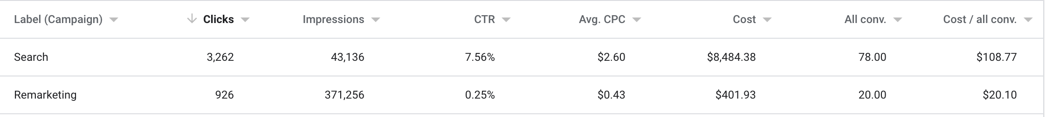
PERFORMANCE DATA

