Slide 1

Criminal Law
ANOTHER RETARGETING SUCCESS STORY
GEO-TARGETING: FLORIDA

Slide 2
HIGHLIGHTS
CLIENT GOAL:
$450
CPL
TALKING POINTS
Remarketing CPA is $68 compared to search CPA of $439
Retargeting was responsible for a 16% increase in leads compared to only running search ads.
Age of account is 8 months.
Client has given us an unlimited budget based on consistent performance over time.
RESULTS
OUR RESULTS:
$68.48
Retargeting
CPA
Average CPA is $387.55
across the account as a whole

Slide 3
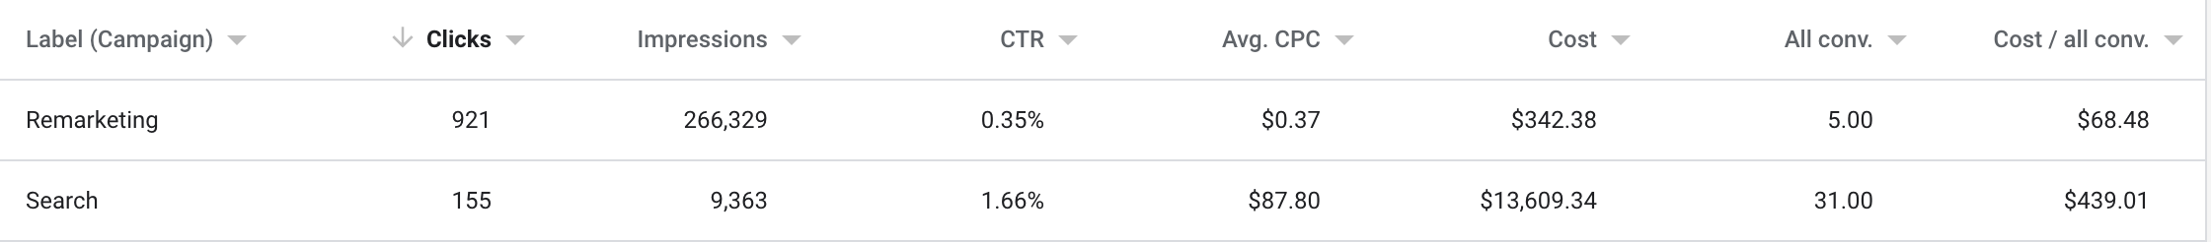
PERFORMANCE DATA

