Slide 1

[FENCING CONTRACTOR]
ANOTHER RETARGETING SUCCESS STORY
GEO-TARGETING: [WI]

Slide 2
HIGHLIGHTS
CLIENT GOAL:
$30
CPL
TALKING POINTS
Retargeting contributes 12% of conversions
Cost per conversion is 23% of regular campaigns
Search campaigns included branded search which weakens the comparison
Campaign running for 1 year now.
Monthly budget $1k
RESULTS
OUR RESULTS:
$4.50
Retargeting
CPA
Average CPA is $20.81
across the account as a whole

Slide 3
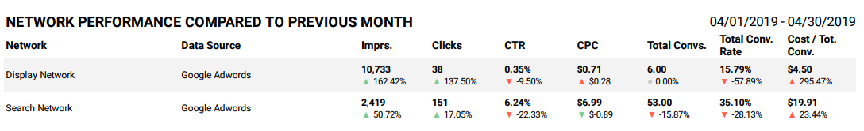
PERFORMANCE DATA

Slide 4


AD EXAMPLES

