Slide 1

[ROOFING INSTALL]
ANOTHER RETARGETING SUCCESS STORY
GEO-TARGETING: [FLORIDA]

Slide 2
HIGHLIGHTS
CLIENT GOAL:
$90
CPL
TALKING POINTS
Retargeting accounts for almost ⅓ of all conversions
Average retargeting CPC is $0.33 compared to $8.20 on search
Established account
Only has $1k monthly budget for total account, retargeting spends $150.
RESULTS
OUR RESULTS:
$29
Retargeting
CPA
Average CPA is $63
across the account as a whole

Slide 3
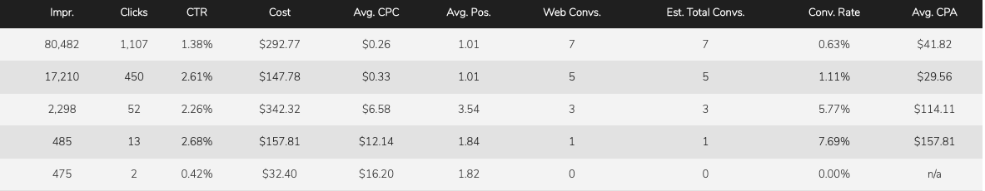
PERFORMANCE DATA

Slide 4


AD EXAMPLES

